Slide 1
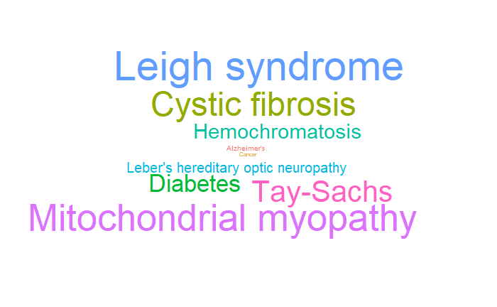
An Exploratory Analysis of Common Genetic Disorders
a humble demonstration of plotting skills
Arjun, Flynn, Ricardo, Brandon 3/1/2022

Slide 2
For this project we will be analyzing the data frame “train.csv” sourced from the website, “Kaggle”, the data is about contains medical information about children who have genetic disorders.

Slide 3
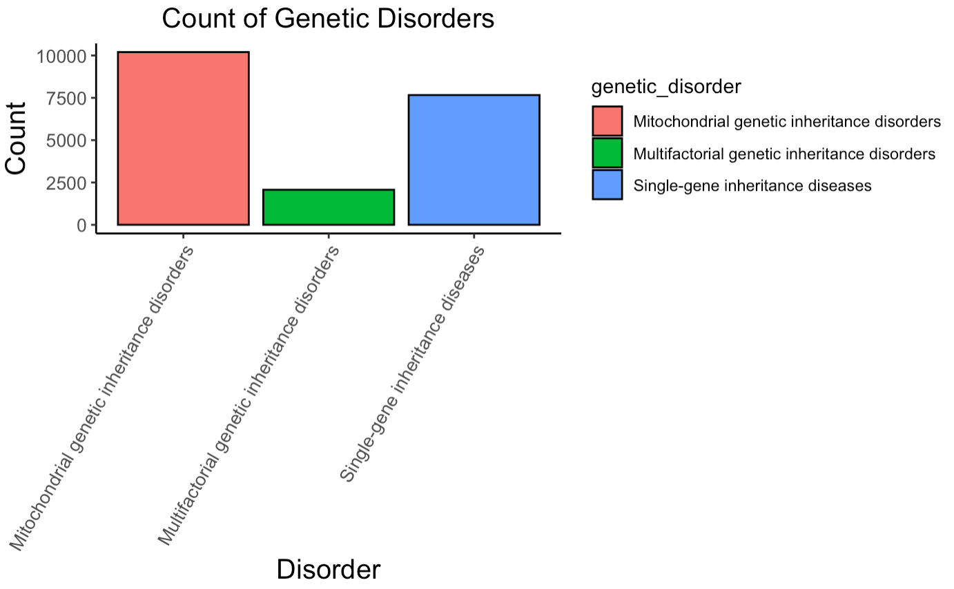
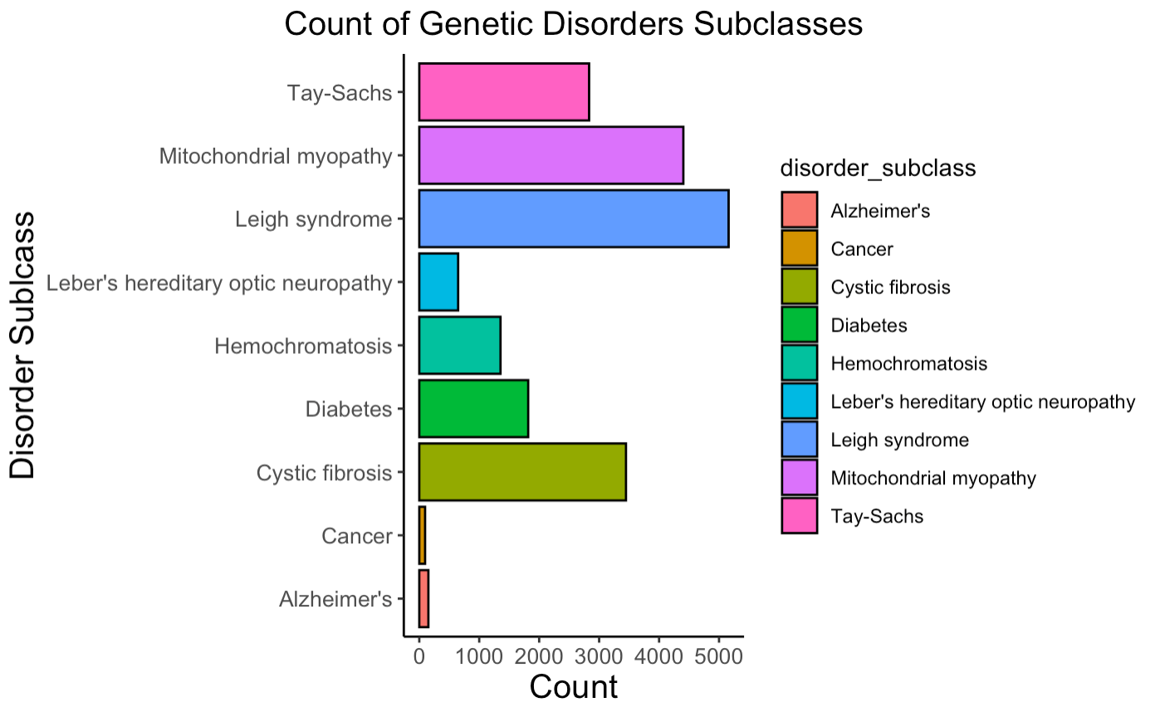
Let’s get a general idea of what we are working with-
Notes:
Childhood Alzheimer's is a term used to refer to two different diseases that cause children to have memory loss and other symptoms commonly associated with Alzheimer's disease. Childhood Alzheimer's can refer to: Niemann-Pick disease type C (NPC) Sanfilippo syndrome or mucopolysaccharidosis type III (MPS III)

Slide 4
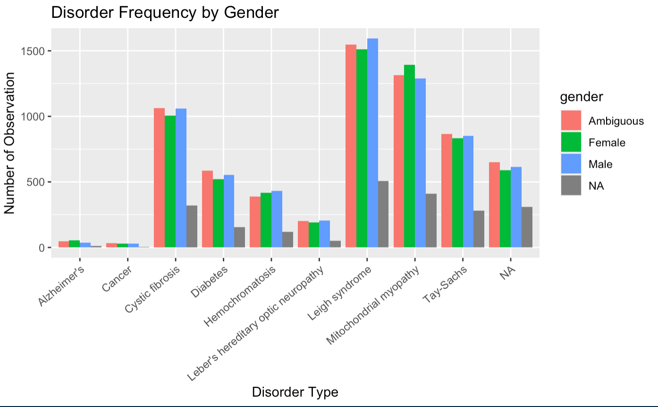
How is the Data distributed among genders?
And what is the relative representation of each Disorder?

Slide 5
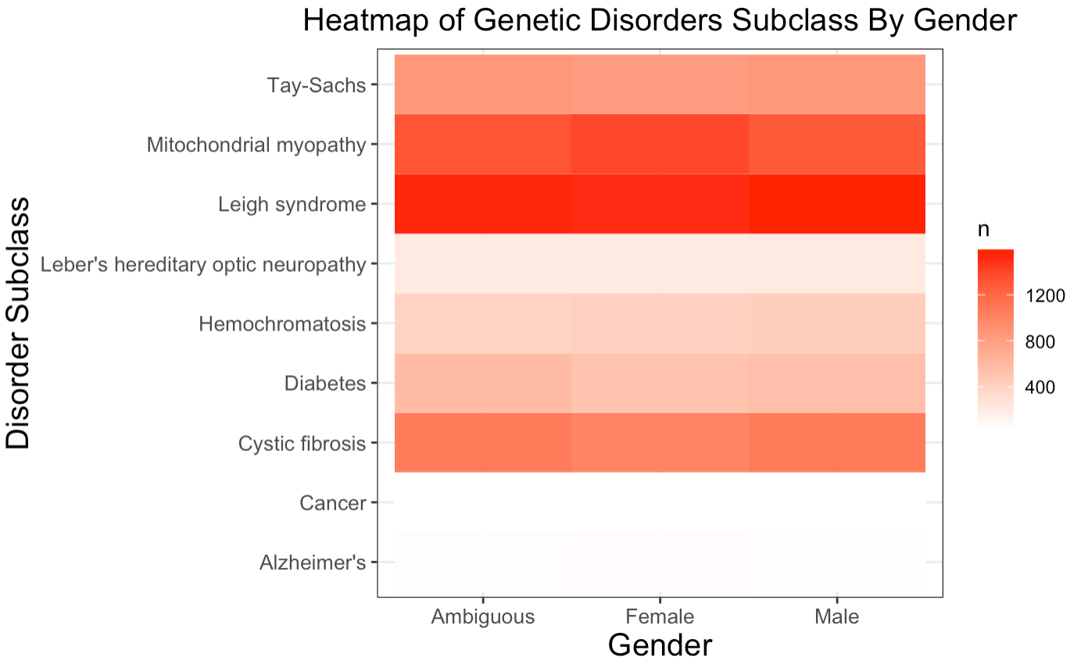
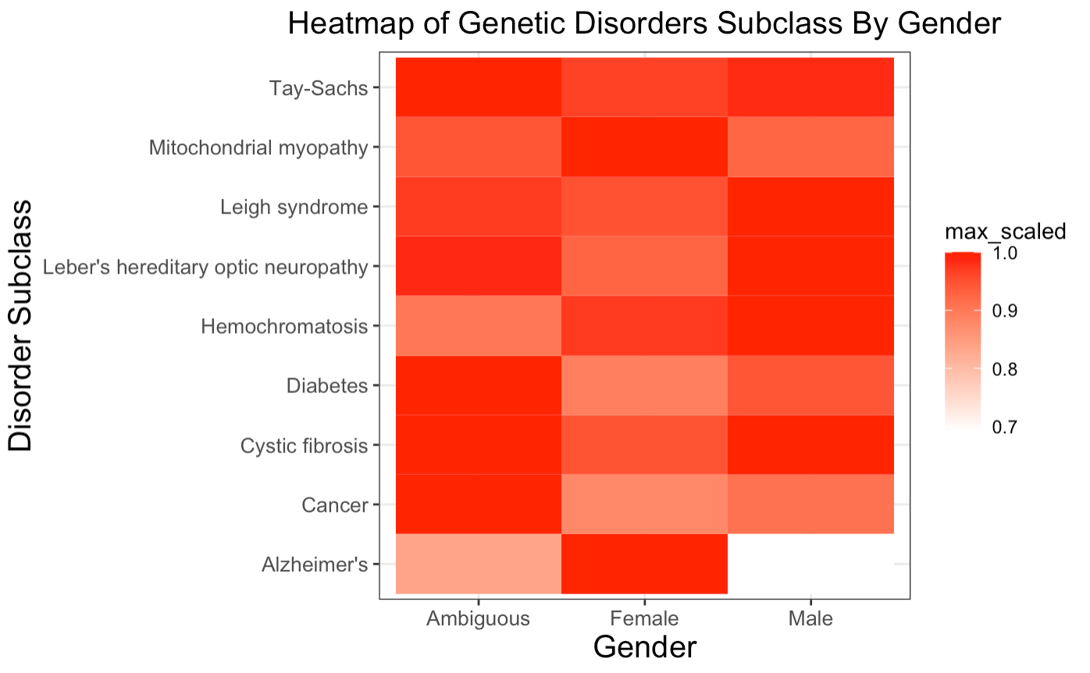
If you hate bar graphs and love heat maps, well your in luck, we have that too

Slide 6
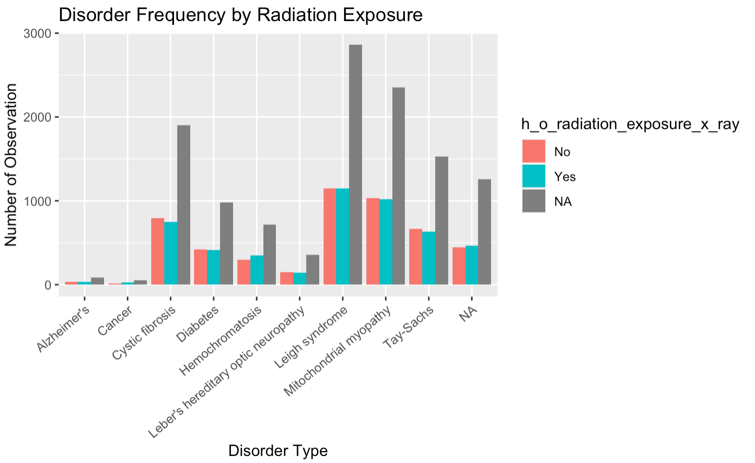
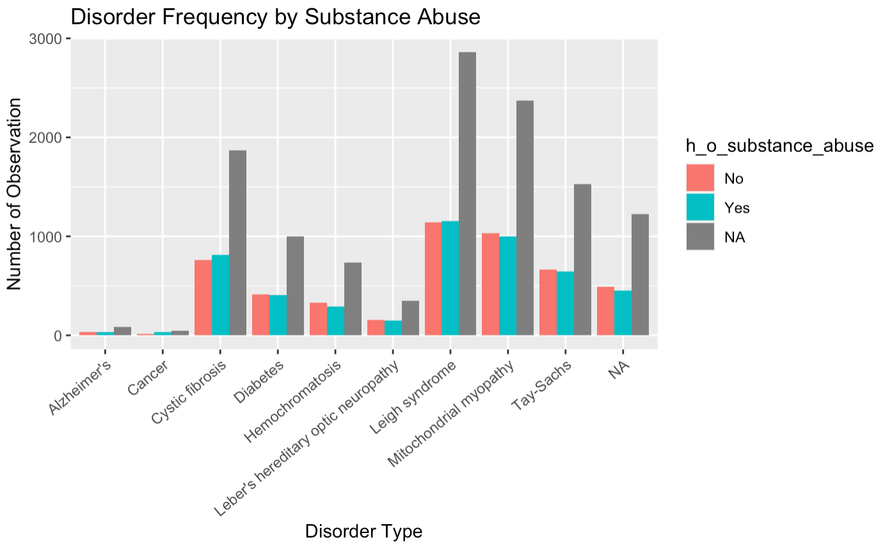
History is a major contributing factor in Genetic Disorders, so
Let’s look at some variables of it-

Slide 7
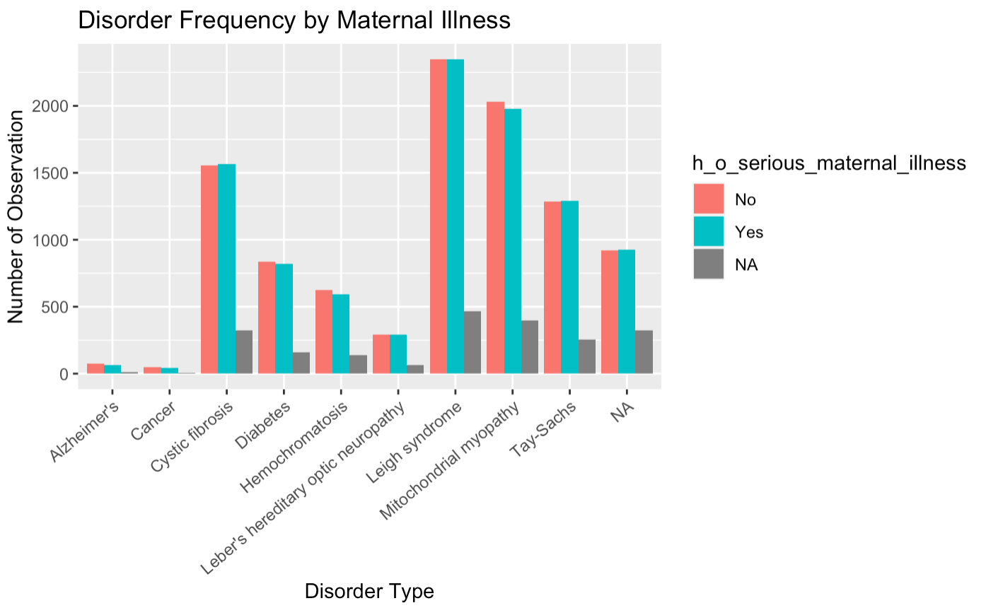
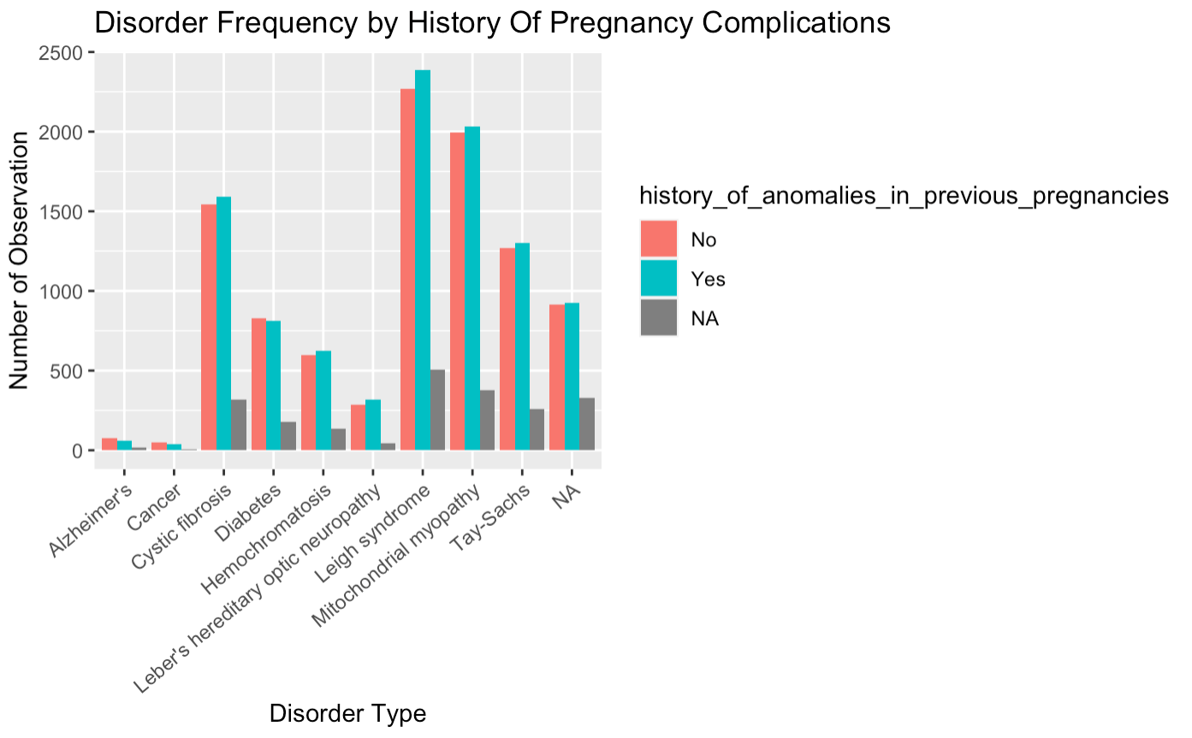
Two Additional Aspect to Consider-

Slide 8
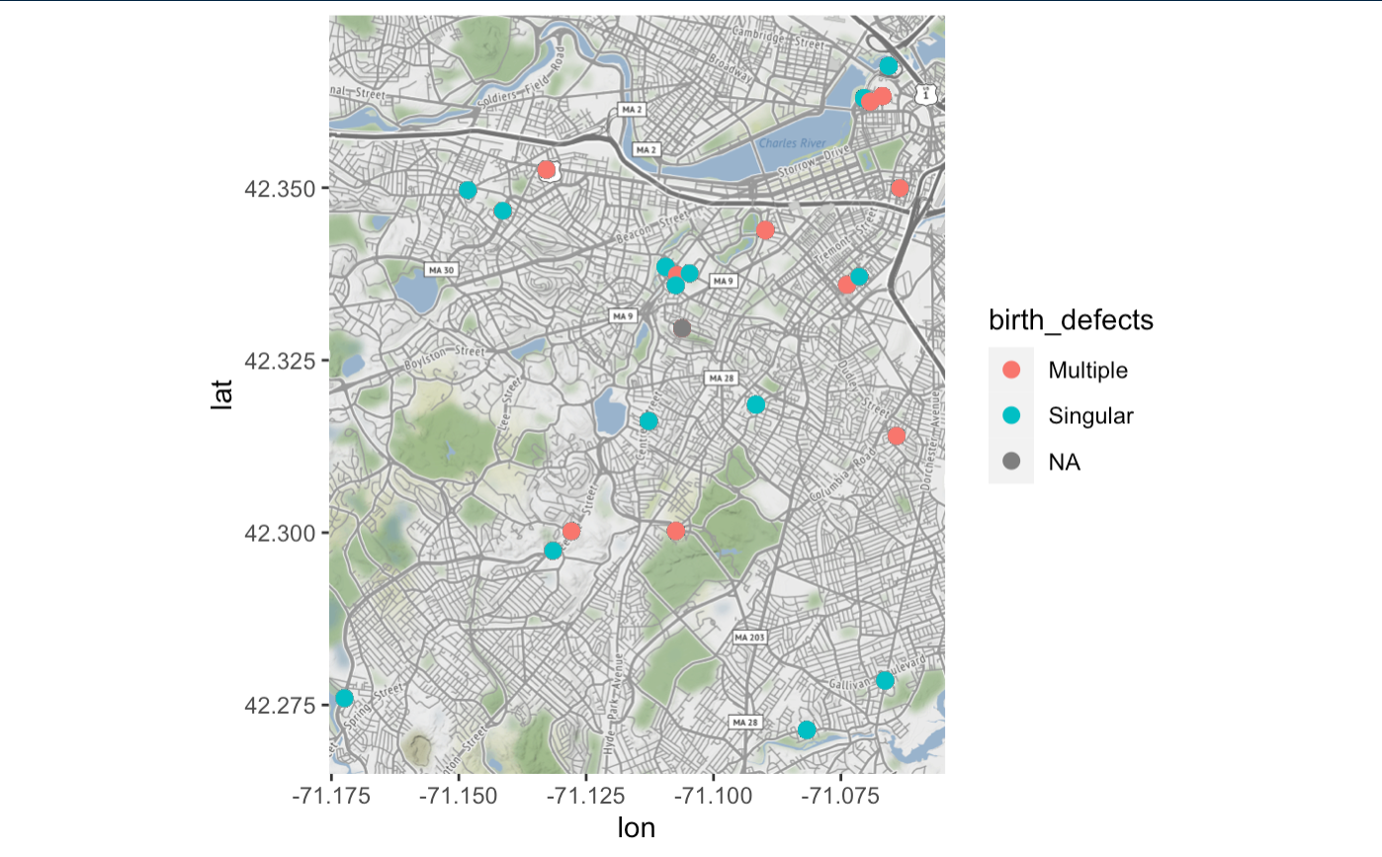
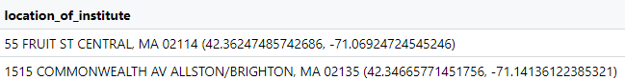
Genetic Disorders can sometimes be localized due to environmental conditions, lets see if this is shown in our data-

Slide 9
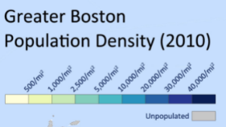
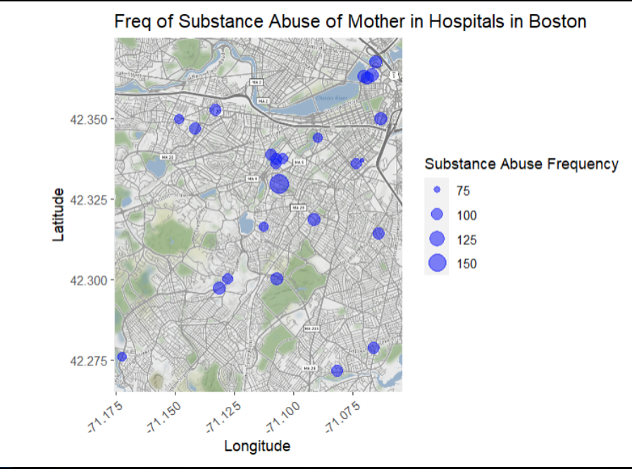
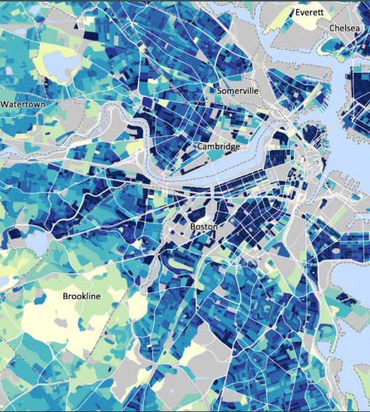
How Does History of Substance Abuse play into this-

Slide 10
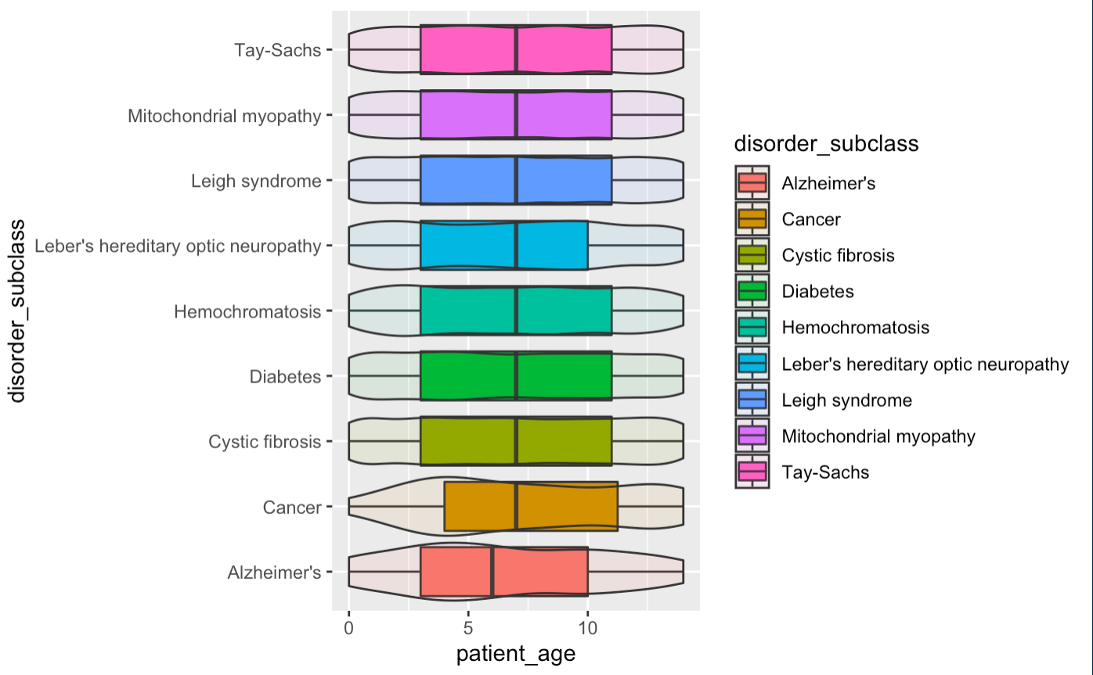
Genetic Disorders can be differentially represented based on age, due to a variety of factors, so let’s exam this-
← Ahh, yes, this makes sense

Slide 11
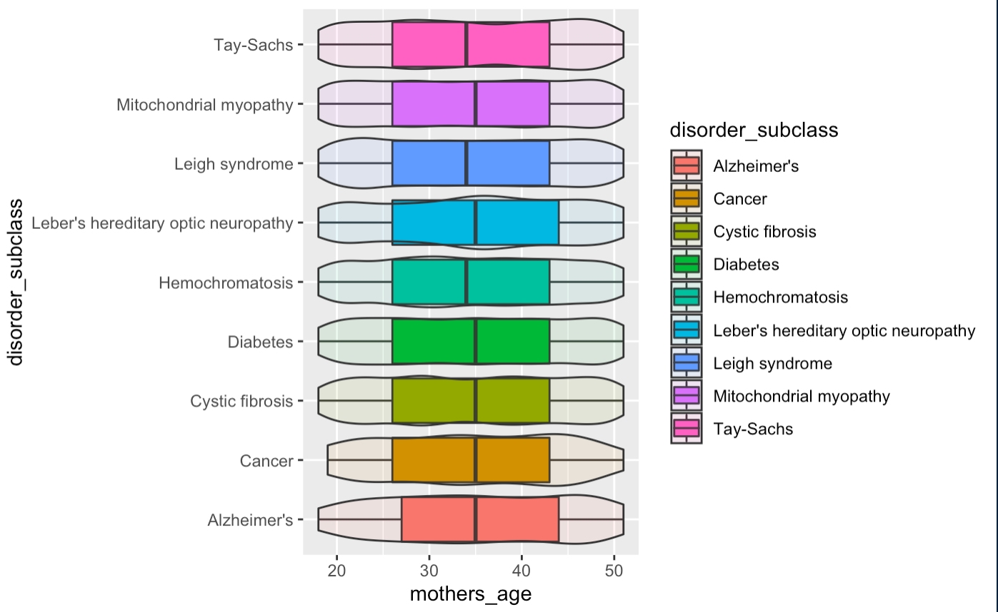
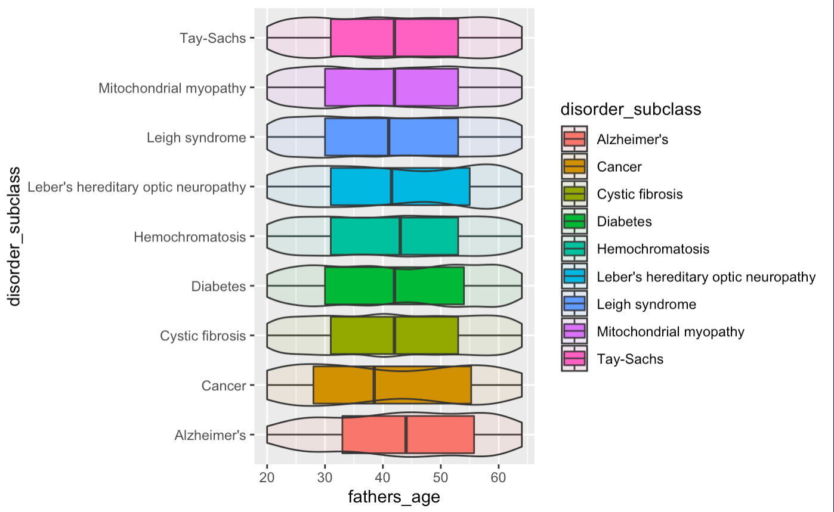
It may also be interesting to see where the parents age ranges fall for these disorders

Slide 12
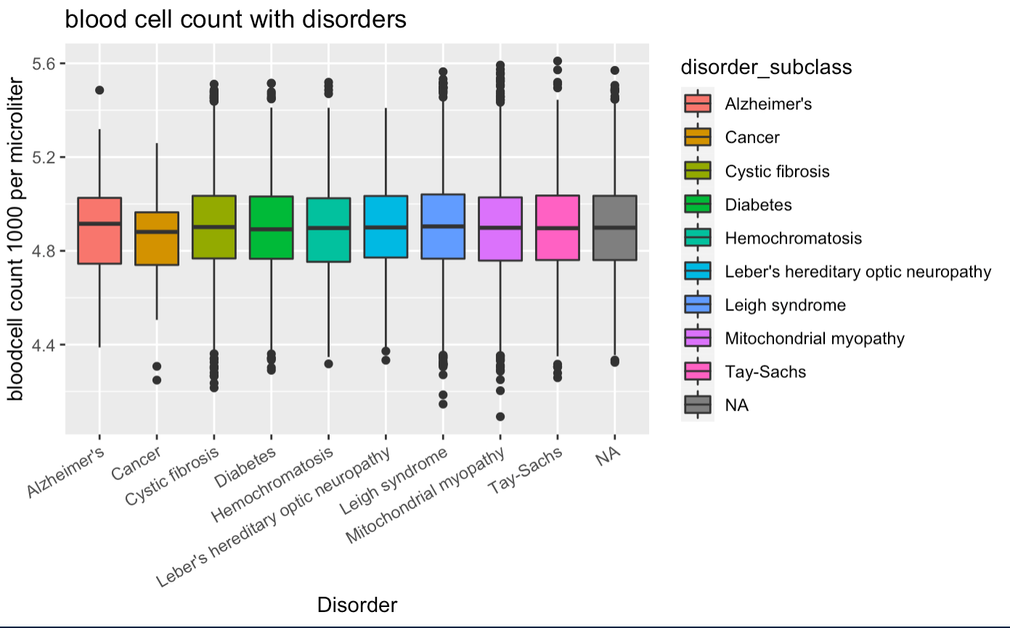
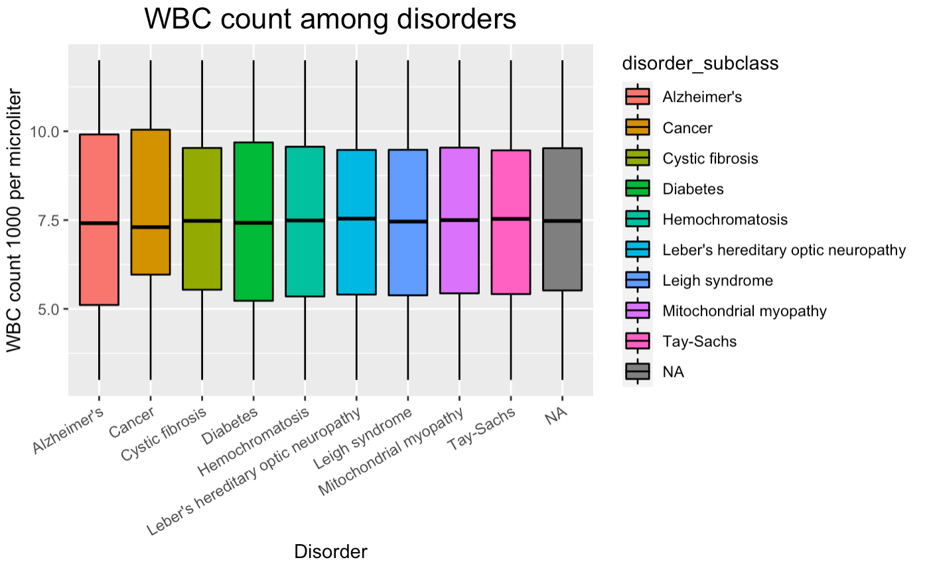
Another feature widely affected by genetic disorders can be blood cell count so let’s take a look at that as well-

Slide 13
Now, you, being a rational individual may be wondering, why there does not seem to be any obvious relationships between some variables and disorders
Some of the disorders represented are based on a wide variety of interacting factors
This data set may be limited in the scope of its data
This is what can happen when analysing data some times, and that’s okay, to find a relationship in every analysis would be suggestive that you are desperate to find one, in science that would be akin to a bias, don’t be biased

